Slide 1
Data Structure and Algorithm (PMSCS 623P)
Lecture 13
Dynamic Programming
(0-1 knapsack problem)

Slide 2
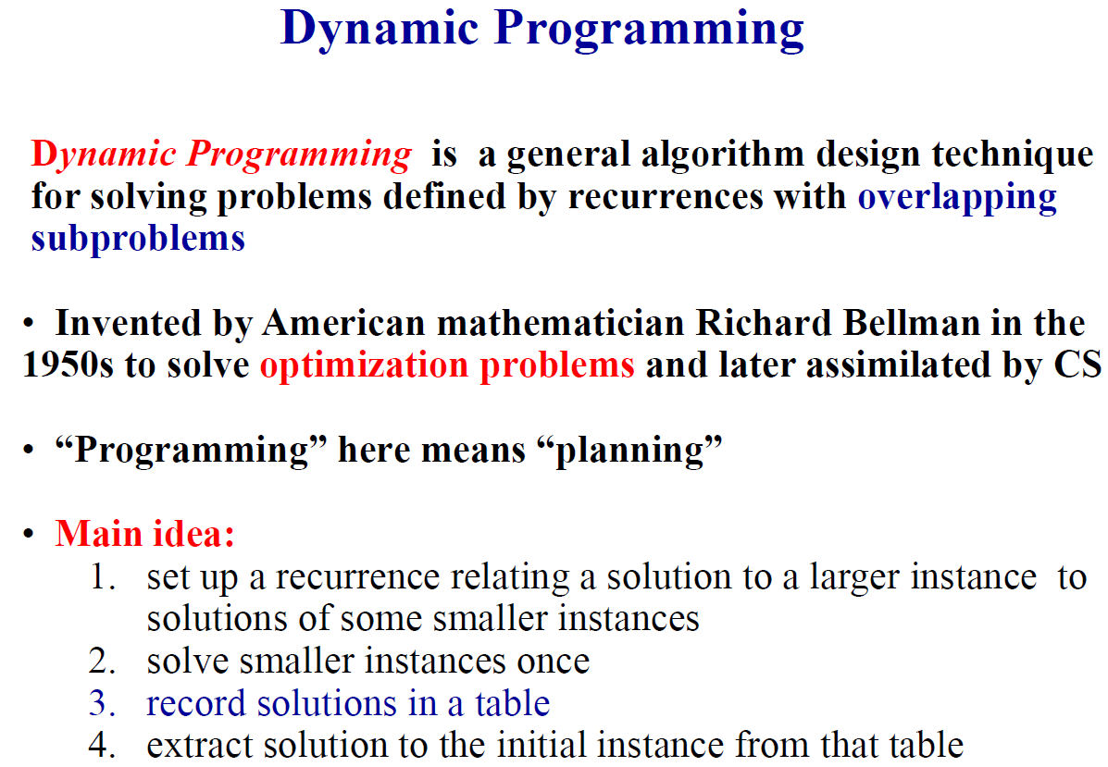

Slide 3
Dynamic Programming (DP)
Build up the solution by computing solutions to the subproblems.
Don’t solve the same subproblem twice, but rather save the solution so it can be re-used later on.
Often used for a large class to optimization problems.
Unlike Greedy algorithms, implicitly solve all subproblems.
Motivating the case for DP with Memoization – a top-down technique, and then moving on to Dynamic Programming – a bottom-up technique.

Slide 4
The Knapsack Problem
The 0-1 knapsack problem
A thief robbing a store finds n items: the i-th item is worth v_{i} dollars and weights w_{i} pounds (v_{i}, w_{i} integers)
The thief can only carry W pounds in his knapsack
Items must be taken entirely or left behind
Which items should the thief take to maximize the value of his load?
The fractional knapsack problem
Similar to above
The thief can take fractions of items
Solvable via a greedy approach (always take from that item which has the highest per weight value)

Slide 5
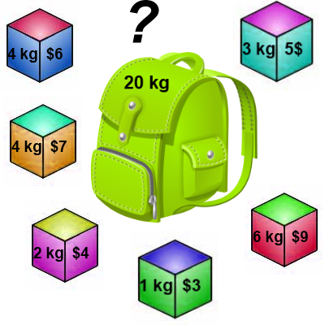
Knapsack 0-1 Problem
The goal is to maximize the value of a knapsack that can hold at most W units (i.e. lbs or kg) worth of goods from a list of items I₀, I₁, … I_{n-1}.
Each item has 2 attributes:
Value – let this be v_{i} for item I_{i}
Weight – let this be w_{i} for item I_{i}

Slide 6
Knapsack 0-1 Problem
The difference between this problem and the fractional knapsack one is that you CANNOT take a fraction of an item.
You can either take it or not.
Hence the name Knapsack 0-1 problem.

Slide 7
0-1 Knapsack problem
Given a knapsack with maximum capacity W, and a set S consisting of n items
Each item i has some weight w_{i} and benefit value b_{i} (all w_{i} and W are integer values)
Problem: How to pack the knapsack to achieve maximum total value of packed items?

Slide 8
0-1 Knapsack problem
Problem, in other words, is to find
The problem is called a “0-1” problem, because each item must be entirely accepted or rejected.

Slide 9
0-1 Knapsack problem: brute-force approach
Let’s first solve this problem with a straightforward algorithm
Since there are n items, there are 2^{n} possible combinations of items.
We go through all combinations and find the one with maximum value and with total weight less or equal to W
Running time will be O(2^{n})

Slide 10
0-1 Knapsack - Greedy Strategy
E.g.:
50
50
30
Item 3
$120
+
Item 2
30
20
$100
+
Item 1
20
20
$100
10
10
$60
$60
$100
$120
Knapsack capacity,
W = 50 pounds
$160
$220
(optimal solution)
$6/pound
$5/pound
$4/pound
Greedy algorithm doesn’t give optimal solution
Because the greedy choice property does not hold: no solution containing the first greedy choice (item 1) gives an optimal solution

Slide 11
0-1 Knapsack problem: dynamic programming approach
We can do better with an algorithm based on dynamic programming
We need to carefully identify the subproblems

Slide 12
Defining a Subproblem
We can do better with an algorithm based on dynamic programming
We need to carefully identify the subproblems
Let’s try this:
If items are labeled 1..n, then a subproblem
would be to find an optimal solution for
S_{k} = {items labeled 1, 2, .. k}

Slide 13
Defining a Subproblem
If items are labeled 1..n, then a subproblem would be to find an optimal solution for S_{k} = {items labeled 1, 2, .. k}
This is a reasonable subproblem definition.
The question is: can we describe the final solution (S_{n} ) in terms of subproblems (S_{k})?
Unfortunately, we can’t do that.

Slide 14
Defining a Subproblem
w₁ =2
b₁ =3
w₂ =4
b₂ =5
w₃ =5
b₃ =8
w₄ =3
b₄ =4
Weight
Benefit
Item
#
w_{i}
b_{i}
?
1
2
3
Max weight: W = 20
For S₄:
Total weight: 14
Maximum benefit: 20
S₄
2
4
5
S₅
3
5
8
4
3
4
5
9
10
w₁ =2
b₁ =3
w₂ =4
b₂ =5
w₃ =5
b₃ =8
w₅ =9
b₅ =10
Solution for S₄ is not part of the solution for S₅!!!
For S₅:
Total weight: 20
Maximum benefit: 26

Slide 15
Defining a Subproblem
As we have seen, the solution for S₄ is not part of the solution for S₅
So our definition of a subproblem is flawed and we need another one!
But this definition did not consider the knapsack capacity!!!

Slide 16
Defining a Subproblem
Let’s add another parameter: w, which will represent the maximum weight for each subset of items
The subproblem then will be to compute V[k,w], i.e., to find an optimal solution for S_{k} = {items labeled 1, 2, .. k} in a knapsack of size w

Slide 17
Recursive Formula for subproblems
The subproblem will then be to compute V[k,w], i.e., to find an optimal solution for S_{k} = {items labeled 1, 2, .. k} in a knapsack of size w
Assuming knowing V[i, j], where i=0,1, 2, … k-1, j=0,1,2, …w, how to derive V[k,w]?

Slide 18
Recursive Formula for subproblems (continued)
Recursive formula for subproblems:
It means, that the best subset of S_{k} that has total weight w is:
1) the best subset of S_{k-1} that has total weight ≤ w, or
2) the best subset of S_{k-1} that has total weight ≤ w-w_{k} plus the item k

Slide 19
Recursive Formula
The best subset of S_{k} that has the total weight ≤ w, either contains item k or not.
First case: w_{k}>w. Item k can’t be part of the solution, since if it was, the total weight would be > w, which is unacceptable.
Second case: w_{k} ≤ w. Then the item k can be in the solution, and we choose the case with greater value.

Slide 20
0-1 Knapsack Algorithm
for w = 0 to W
V[0,w] = 0
for i = 1 to n
V[i,0] = 0
for i = 1 to n
for w = 0 to W
if w_{i} <= w // item i can be part of the solution
if b_{i} + V[i-1,w-w_{i}] > V[i-1,w]
V[i,w] = b_{i} + V[i-1,w- w_{i}]
else
V[i,w] = V[i-1,w]
else V[i,w] = V[i-1,w] // w_{i} > w

Slide 21
Running time
O(W)
for w = 0 to W
V[0,w] = 0
for i = 1 to n
V[i,0] = 0
for i = 1 to n
for w = 0 to W
< the rest of the code >
Repeat n times
O(W)
What is the running time of this algorithm?
O(n*W)
Remember that the brute-force algorithm
takes O(2^{n})

Slide 22
Example
Let’s run our algorithm on the
following data:
n = 4 (# of elements)
W = 5 (max weight)
Elements (weight, benefit):
(2,3), (3,4), (4,5), (5,6)

Slide 23
Example
i\W
0
1
2
3
4
5
0
0
0
0
0
0
0
1
2
3
4
for w = 0 to W
V[0,w] = 0

Slide 24
Example
i\W
0
1
2
3
4
5
0
0
0
0
0
0
0
1
0
2
0
3
0
4
0
for i = 1 to n
V[i,0] = 0

Slide 25
Example
Items:
1: (2,3)
2: (3,4)
3: (4,5)
4: (5,6)
i\W
0
1
2
3
4
5
i=1
b_{i}=3
w_{i}=2
w=1
w-w_{i} =-1
0
0
0
0
0
0
0
1
0
0
2
0
3
0
4
0
if w_{i} <= w // item i can be part of the solution
if b_{i} + V[i-1,w-w_{i}] > V[i-1,w]
V[i,w] = b_{i} + V[i-1,w- w_{i}]
else
V[i,w] = V[i-1,w]
else V[i,w] = V[i-1,w] // w_{i} > w

Slide 26
Example
Items:
1: (2,3)
2: (3,4)
3: (4,5)
4: (5,6)
i\W
0
1
2
3
4
5
i=1
b_{i}=3
w_{i}=2
w=2
w-w_{i} =0
0
0
0
0
0
0
0
1
0
0
3
2
0
3
0
4
0
if w_{i} <= w // item i can be part of the solution
if b_{i} + V[i-1,w-w_{i}] > V[i-1,w]
V[i,w] = b_{i} + V[i-1,w- w_{i}]
else
V[i,w] = V[i-1,w]
else V[i,w] = V[i-1,w] // w_{i} > w

Slide 27
Example
Items:
1: (2,3)
2: (3,4)
3: (4,5)
4: (5,6)
i\W
0
1
2
3
4
5
i=1
b_{i}=3
w_{i}=2
w=3
w-w_{i} =1
0
0
0
0
0
0
0
1
0
0
3
3
2
0
3
0
4
0
if w_{i} <= w // item i can be part of the solution
if b_{i} + V[i-1,w-w_{i}] > V[i-1,w]
V[i,w] = b_{i} + V[i-1,w- w_{i}]
else
V[i,w] = V[i-1,w]
else V[i,w] = V[i-1,w] // w_{i} > w

Slide 28
Example
Items:
1: (2,3)
2: (3,4)
3: (4,5)
4: (5,6)
i\W
0
1
2
3
4
5
i=1
b_{i}=3
w_{i}=2
w=4
w-w_{i} =2
0
0
0
0
0
0
0
1
0
0
3
3
3
2
0
3
0
4
0
if w_{i} <= w // item i can be part of the solution
if b_{i} + V[i-1,w-w_{i}] > V[i-1,w]
V[i,w] = b_{i} + V[i-1,w- w_{i}]
else
V[i,w] = V[i-1,w]
else V[i,w] = V[i-1,w] // w_{i} > w

Slide 29
Example
Items:
1: (2,3)
2: (3,4)
3: (4,5)
4: (5,6)
i\W
0
1
2
3
4
5
i=1
b_{i}=3
w_{i}=2
w=5
w-w_{i} =3
0
0
0
0
0
0
0
1
0
0
3
3
3
3
2
0
3
0
4
0
if w_{i} <= w // item i can be part of the solution
if b_{i} + V[i-1,w-w_{i}] > V[i-1,w]
V[i,w] = b_{i} + V[i-1,w- w_{i}]
else
V[i,w] = V[i-1,w]
else V[i,w] = V[i-1,w] // w_{i} > w

Slide 30
Example
Items:
1: (2,3)
2: (3,4)
3: (4,5)
4: (5,6)
i\W
0
1
2
3
4
5
i=2
b_{i}=4
w_{i}=3
w=1
w-w_{i} =-2
0
0
0
0
0
0
0
1
0
0
3
3
3
3
2
0
0
3
0
4
0
if w_{i} <= w // item i can be part of the solution
if b_{i} + V[i-1,w-w_{i}] > V[i-1,w]
V[i,w] = b_{i} + V[i-1,w- w_{i}]
else
V[i,w] = V[i-1,w]
else V[i,w] = V[i-1,w] // w_{i} > w

Slide 31
Example
Items:
1: (2,3)
2: (3,4)
3: (4,5)
4: (5,6)
i\W
0
1
2
3
4
5
i=2
b_{i}=4
w_{i}=3
w=2
w-w_{i} =-1
0
0
0
0
0
0
0
1
0
0
3
3
3
3
2
0
0
3
3
0
4
0
if w_{i} <= w // item i can be part of the solution
if b_{i} + V[i-1,w-w_{i}] > V[i-1,w]
V[i,w] = b_{i} + V[i-1,w- w_{i}]
else
V[i,w] = V[i-1,w]
else V[i,w] = V[i-1,w] // w_{i} > w

Slide 32
Example
Items:
1: (2,3)
2: (3,4)
3: (4,5)
4: (5,6)
i\W
0
1
2
3
4
5
i=2
b_{i}=4
w_{i}=3
w=3
w-w_{i} =0
0
0
0
0
0
0
0
1
0
0
3
3
3
3
2
0
0
3
4
3
0
4
0
if w_{i} <= w // item i can be part of the solution
if b_{i} + V[i-1,w-w_{i}] > V[i-1,w]
V[i,w] = b_{i} + V[i-1,w- w_{i}]
else
V[i,w] = V[i-1,w]
else V[i,w] = V[i-1,w] // w_{i} > w

Slide 33
Example
Items:
1: (2,3)
2: (3,4)
3: (4,5)
4: (5,6)
i\W
0
1
2
3
4
5
i=2
b_{i}=4
w_{i}=3
w=4
w-w_{i} =1
0
0
0
0
0
0
0
1
0
0
3
3
3
3
2
0
0
3
4
4
3
0
4
0
if w_{i} <= w // item i can be part of the solution
if b_{i} + V[i-1,w-w_{i}] > V[i-1,w]
V[i,w] = b_{i} + V[i-1,w- w_{i}]
else
V[i,w] = V[i-1,w]
else V[i,w] = V[i-1,w] // w_{i} > w

Slide 34
Example
Items:
1: (2,3)
2: (3,4)
3: (4,5)
4: (5,6)
i\W
0
1
2
3
4
5
i=2
b_{i}=4
w_{i}=3
w=5
w-w_{i} =2
0
0
0
0
0
0
0
1
0
0
3
3
3
3
2
0
0
3
4
4
7
3
0
4
0
if w_{i} <= w // item i can be part of the solution
if b_{i} + V[i-1,w-w_{i}] > V[i-1,w]
V[i,w] = b_{i} + V[i-1,w- w_{i}]
else
V[i,w] = V[i-1,w]
else V[i,w] = V[i-1,w] // w_{i} > w

Slide 35
Example
Items:
1: (2,3)
2: (3,4)
3: (4,5)
4: (5,6)
i\W
0
1
2
3
4
5
i=3
b_{i}=5
w_{i}=4
w= 1..3
0
0
0
0
0
0
0
1
0
0
3
3
3
3
2
0
0
3
4
4
7
3
0
0
3
4
4
0
if w_{i} <= w // item i can be part of the solution
if b_{i} + V[i-1,w-w_{i}] > V[i-1,w]
V[i,w] = b_{i} + V[i-1,w- w_{i}]
else
V[i,w] = V[i-1,w]
else V[i,w] = V[i-1,w] // w_{i} > w

Slide 36
Example
Items:
1: (2,3)
2: (3,4)
3: (4,5)
4: (5,6)
i\W
0
1
2
3
4
5
i=3
b_{i}=5
w_{i}=4
w= 4
w- w_{i}=0
0
0
0
0
0
0
0
1
0
0
3
3
3
3
2
0
0
3
4
4
7
3
0
0
3
4
5
4
0
if w_{i} <= w // item i can be part of the solution
if b_{i} + V[i-1,w-w_{i}] > V[i-1,w]
V[i,w] = b_{i} + V[i-1,w- w_{i}]
else
V[i,w] = V[i-1,w]
else V[i,w] = V[i-1,w] // w_{i} > w

Slide 37
Example
Items:
1: (2,3)
2: (3,4)
3: (4,5)
4: (5,6)
i\W
0
1
2
3
4
5
i=3
b_{i}=5
w_{i}=4
w= 5
w- w_{i}=1
0
0
0
0
0
0
0
1
0
0
3
3
3
3
2
0
0
3
4
4
7
3
0
0
3
4
5
7
4
0
if w_{i} <= w // item i can be part of the solution
if b_{i} + V[i-1,w-w_{i}] > V[i-1,w]
V[i,w] = b_{i} + V[i-1,w- w_{i}]
else
V[i,w] = V[i-1,w]
else V[i,w] = V[i-1,w] // w_{i} > w

Slide 38
Example
Items:
1: (2,3)
2: (3,4)
3: (4,5)
4: (5,6)
i\W
0
1
2
3
4
5
i=4
b_{i}=6
w_{i}=5
w= 1..4
0
0
0
0
0
0
0
1
0
0
3
3
3
3
2
0
0
3
4
4
7
3
0
0
3
4
5
7
4
0
0
3
4
5
if w_{i} <= w // item i can be part of the solution
if b_{i} + V[i-1,w-w_{i}] > V[i-1,w]
V[i,w] = b_{i} + V[i-1,w- w_{i}]
else
V[i,w] = V[i-1,w]
else V[i,w] = V[i-1,w] // w_{i} > w

Slide 39
Example
Items:
1: (2,3)
2: (3,4)
3: (4,5)
4: (5,6)
i\W
0
1
2
3
4
5
i=4
b_{i}=6
w_{i}=5
w= 5
w- w_{i}=0
0
0
0
0
0
0
0
1
0
0
3
3
3
3
2
0
0
3
4
4
7
3
0
0
3
4
5
7
4
0
0
3
4
5
7
if w_{i} <= w // item i can be part of the solution
if b_{i} + V[i-1,w-w_{i}] > V[i-1,w]
V[i,w] = b_{i} + V[i-1,w- w_{i}]
else
V[i,w] = V[i-1,w]
else V[i,w] = V[i-1,w] // w_{i} > w

Slide 40
Comments
This algorithm only finds the max possible value that can be carried in the knapsack
i.e., the value in V[n,W]
To know the items that make this maximum value, an addition to this algorithm is necessary

Slide 41
How to find actual Knapsack Items
All of the information we need is in the table.
V[n,W] is the maximal value of items that can be placed in the Knapsack.
Let i=n and k=W
if V[i,k] ≠ V[i−1,k] then
mark the i^{th} item as in the knapsack
i = i−1, k = k-w_{i}
else
i = i−1 // Assume the i^{th} item is not in the knapsack
// Could it be in the optimally packed knapsack?

Slide 42
Finding the Items
Items:
1: (2,3)
2: (3,4)
3: (4,5)
4: (5,6)
i\W
0
1
2
3
4
5
i=4
k= 5
b_{i}=6
w_{i}=5
V[i,k] = 7
V[i−1,k] =7
0
0
0
0
0
0
0
1
0
0
3
3
3
3
2
0
0
3
4
4
7
3
0
0
3
4
5
7
4
0
0
3
4
5
7
i=n, k=W
while i,k > 0
if V[i,k] ≠ V[i−1,k] then
mark the i^{th} item as in the knapsack
i = i−1, k = k-w_{i}
else
i = i−1

Slide 43
Finding the Items
Items:
1: (2,3)
2: (3,4)
3: (4,5)
4: (5,6)
i\W
0
1
2
3
4
5
i=4
k= 5
b_{i}=6
w_{i}=5
V[i,k] = 7
V[i−1,k] =7
0
0
0
0
0
0
0
1
0
0
3
3
3
3
2
0
0
3
4
4
7
3
0
0
3
4
5
7
4
0
0
3
4
5
7
i=n, k=W
while i,k > 0
if V[i,k] ≠ V[i−1,k] then
mark the i^{th} item as in the knapsack
i = i−1, k = k-w_{i}
else
i = i−1

Slide 44
Finding the Items
Items:
1: (2,3)
2: (3,4)
3: (4,5)
4: (5,6)
i\W
0
1
2
3
4
5
i=3
k= 5
b_{i}=5
w_{i}=4
V[i,k] = 7
V[i−1,k] =7
0
0
0
0
0
0
0
1
0
0
3
3
3
3
2
0
0
3
4
4
7
3
0
0
3
4
5
7
4
0
0
3
4
5
7
i=n, k=W
while i,k > 0
if V[i,k] ≠ V[i−1,k] then
mark the i^{th} item as in the knapsack
i = i−1, k = k-w_{i}
else
i = i−1

Slide 45
Finding the Items
Items:
1: (2,3)
2: (3,4)
3: (4,5)
4: (5,6)
i\W
0
1
2
3
4
5
i=2
k= 5
b_{i}=4
w_{i}=3
V[i,k] = 7
V[i−1,k] =3
k − w_{i}=2
0
0
0
0
0
0
0
1
0
0
3
3
3
3
2
0
0
3
4
4
7
7
3
0
0
3
4
5
7
4
0
0
3
4
5
7
i=n, k=W
while i,k > 0
if V[i,k] ≠ V[i−1,k] then
mark the i^{th} item as in the knapsack
i = i−1, k = k-w_{i}
else
i = i−1

Slide 46
Finding the Items
Items:
1: (2,3)
2: (3,4)
3: (4,5)
4: (5,6)
i\W
0
1
2
3
4
5
i=1
k= 2
b_{i}=3
w_{i}=2
V[i,k] = 3
V[i−1,k] =0
k − w_{i}=0
0
0
0
0
0
0
0
1
0
0
3
3
3
3
3
2
0
0
3
4
4
7
3
0
0
3
4
5
7
4
0
0
3
4
5
7
i=n, k=W
while i,k > 0
if V[i,k] ≠ V[i−1,k] then
mark the i^{th} item as in the knapsack
i = i−1, k = k-w_{i}
else
i = i−1

Slide 47
Finding the Items
Items:
1: (2,3)
2: (3,4)
3: (4,5)
4: (5,6)
i\W
0
1
2
3
4
5
i=0
k= 0
0
0
0
0
0
0
0
1
0
0
3
3
3
3
2
0
0
3
4
4
7
3
0
0
3
4
5
7
The optimal knapsack should contain {1, 2}
4
0
0
3
4
5
7
i=n, k=W
while i,k > 0
if V[i,k] ≠ V[i−1,k] then
mark the n^{th} item as in the knapsack
i = i−1, k = k-w_{i}
else
i = i−1

Slide 48
Memorization (Memory Function Method)
Goal:
Solve only subproblems that are necessary and solve it only once
Memorization is another way to deal with overlapping subproblems in dynamic programming
With memorization, we implement the algorithm recursively:
If we encounter a new subproblem, we compute and store the solution.
If we encounter a subproblem we have seen, we look up the answer
Most useful when the algorithm is easiest to implement recursively
Especially if we do not need solutions to all subproblems.0

Slide 49
0-1 Knapsack Memory Function Algorithm
for i = 1 to n
for w = 1 to W
V[i,w] = -1
for w = 0 to W
V[0,w] = 0
for i = 1 to n
V[i,0] = 0
MFKnapsack(i, w)
if V[i,w] < 0
if w < w_{i}
value = MFKnapsack(i-1, w)
else
value = max(MFKnapsack(i-1, w),
b_{i} + MFKnapsack(i-1, w-w_{i}))
V[i,w] = value
return V[i,w]

Slide 50
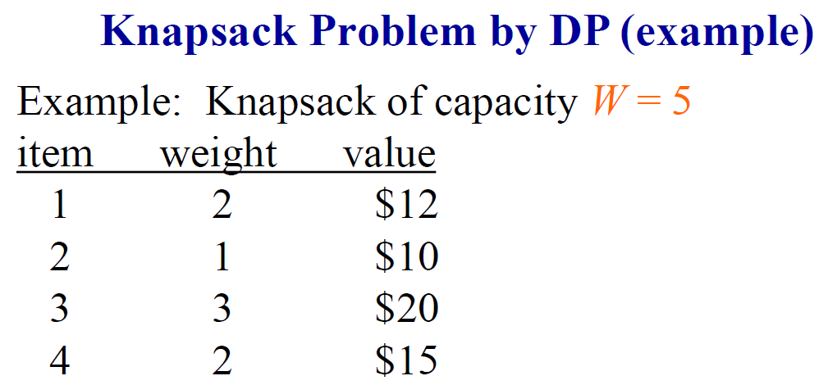

Slide 51
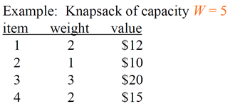
Example
i\W
0
1
2
3
4
5
0
0
0
0
0
0
0
1
2
3
4
for w = 0 to W
V[0,w] = 0

Slide 52
Example
i\W
0
1
2
3
4
5
0
0
0
0
0
0
0
1
0
2
0
3
0
4
0
for i = 1 to n
V[i,0] = 0

Slide 53
Example
i\W
0
1
2
3
4
5
0
0
0
0
0
0
0
1
0
2
0
3
0
4
0
if w_{i} <= w // item i can be part of the solution
if b_{i} + V[i-1,w-w_{i}] > V[i-1,w]
V[i,w] = b_{i} + V[i-1,w- w_{i}]
else
V[i,w] = V[i-1,w]
else V[i,w] = V[i-1,w] // w_{i} > w

